Slide 1
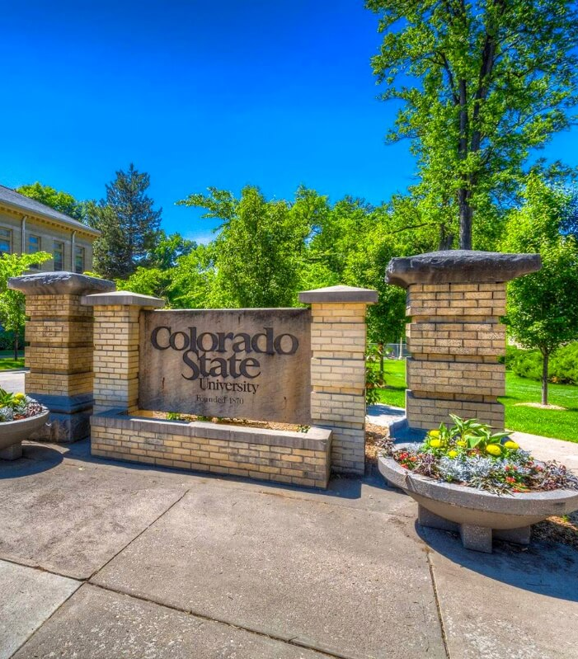
Colorado State University CSA Training

Slide 2
What is the Clery Act?
Lehigh University student Jeanne Clery was raped and murdered in her dorm room in 1986.
Her parents advocated for legislation that would require universities to disclose information regarding crime on college campuses.
The federal Crime Awareness and Campus Security Act was passed in 1990. Today, this act is commonly known as the “Clery Act.”

Slide 3
What is the Clery Act? Continued
Universities must provide:
Select annual crime statistics.
Support for victims of crime.
Policies and Procedures related to the dissemination of timely warnings and emergency notifications, options for survivors of sexual assault, domestic violence, dating violence, and stalking, missing student notifications, and campus crime reporting processes.

Slide 4
What is a CSA?
A Campus Security Authority (CSA) is a specific university employee, student, and/or contractor that is federally mandated under the Clery Act with the responsibility to report crimes that are reported to them. If you have been identified as a CSA your role at CSU falls under one of the following four categories:
You work within the CSU Police Department.
You are not a member of the CSU Police Department but are responsible for campus security.
You have been designated by CSU as somebody to whom crimes should be reported. (e.g., Title IX Coordinator)
You are somebody with significant responsibility for student and campus activities. (e.g., a director who oversees housing; an athletic director; a faculty advisor to a student group or club)
Notes:
Examples of CSAs: RA’s, Director’s of Housing/Residence Life, Directors of Greek Life, Student Resolutions, Coaches, Athletic Directors, Faculty Advisors, Landmark Security, etc.

Slide 5
Who is NOT a CSA?
Faculty who do not have responsibilities outside of the classroom.
For example, taking students on a field trip, acting as an advisor, or coaching students, are all significant responsibilities for student activities that would make one a CSA with respect to that activity.
Physicians or nurses whose only responsibility is to provide care to students.
Pastoral or professional counselors.
Notes:
Pastoral and counseling staff must be working in that capacity.

Slide 6
CSA Responsibilities
CSAs are federally obligated to report crimes that are reported to them.
Reports should be made as soon as reasonably possible.
CSAs ARE encouraged to assist the victim in reporting.
NOTE: A victim can choose not to report, however a CSA is still obligated to report.
CSAs are NOT:
Required or expected to investigate.
A confidential resource but can direct others to confidential services, such as the Counseling Center.
Notes:
We have a responsibility to notify our campus community within a reasonable time frame about situations that may impact health and safety.

Slide 7
Clery Reportable Crimes
Criminal Offenses
Hate Crimes
VAWA Offenses
Arrests & Referrals
Criminal Homicide
Sex Offenses
Robbery
Aggravated Assault
Burglary
Motor Vehicle Theft
Arson
Crimes in the criminal offenses column plus:
Larceny Theft
Simple Assault
Intimidation
Destruction, damage, or vandalism of property
Domestic Violence
Dating Violence
Stalking
Weapons Law Violations
Drug Law Violations
Liquor Law Violations

Slide 8
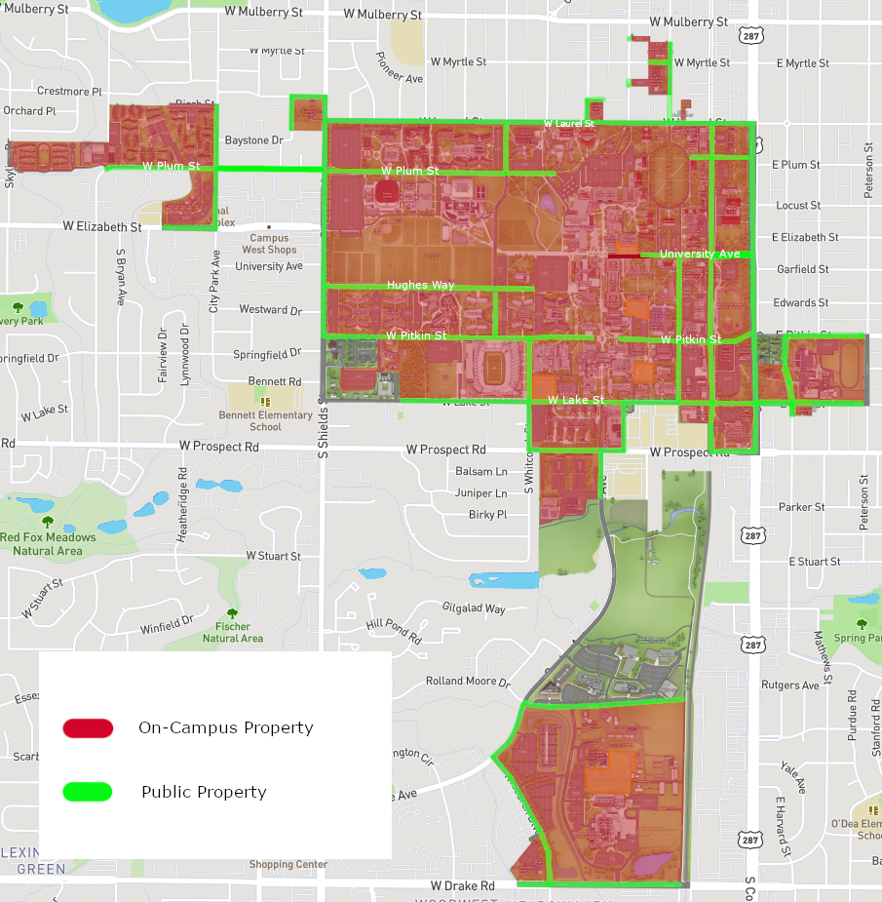
Clery Geography
On-campus
On-campus student housing facility
Public property adjacent to & accessible from campus (Rule of thumb: sidewalk-street-sidewalk)
Any non-campus property or building owned or controlled by the institution or a recognized student organization – this includes hotels and classrooms rented by the institution for overnight, school sponsored trips

Slide 9
Title IX and the Clery Act
Title IX and the Clery Act are two separate federal laws that both address sexual offenses. Below is a chart to clarify the differences and reporting requirements of these laws.
 | Title IX | Clery Act
Titles | All CSU employees and volunteers, including faculty, staff, and students acting in their employment or volunteer roles are Responsible Employees, meaning they are mandatory reporters of any violations or alleged violations of Title IX. Responsible Employees are required to make those reports to the Office of Support and Safety Assessment/Title IX within 24 hours of knowledge of incident. Those exempt only include licensed healthcare professionals and victim advocates. | Only individuals who meet the federal definition are Campus Security Authorities.
Overview | Title IX is concerned with any incident of sex-based discrimination that occurs whether it involves a student, faculty, staff member, or guest of CSU. If the incident is made known by a Responsible Employee, it is required to be reported regardless of when or where the incident occurred. Resources are available for any party. | Clery is concerned with where and what crime occurred. If a Clery crime occurs in a Clery reportable area, it should be reported. It does not matter if the victim or perpetrator is associated with the university.
Intersections | Both Title IX and the Clery Act address sexual offenses. While many of the processes to resolve sexual offenses are the same, there are different reporting processes.
Reporting | Any incident of sexual violence occurring on or off campus should be reported directly to the Office of Support and Safety Assessment/Title IX. | Sexual offenses that occur on campus property should be reported directly to CSUPD. CSUPD works closely with Title IX.

Slide 10
Necessary Information for Reporting
Your name or the name of the reporting person and contact information.
Type of incident (See Clery Crime Reporting Form).
Date incident occurred.
Location of incident.
Description of incident and law enforcement case-number if known.
Whether or not the incident was bias motivated.

Slide 11
Reporting a Clery Crime
Complete the Clery Crime Reporting Form
Complete one form for each crime reported
If no crimes have been committed over the course of a calendar year, you must complete the annual crime report form

Slide 12
Questions?
Contact Information
Rebecca Miller
Clery Compliance Officer
Safety and Risk Services
Rebecca.S.Miller@colostate.edu
970-491-6379

